Slide 1
tables

Slide 2
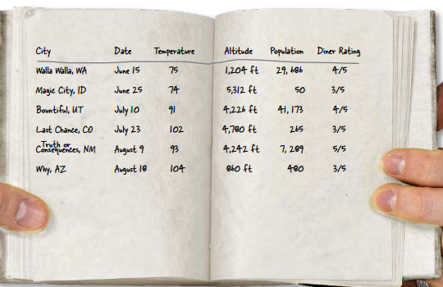
HTML Tables
Sometimes you need to present tabular data, perhaps for inventory of products or a catalog of albums.

Slide 3
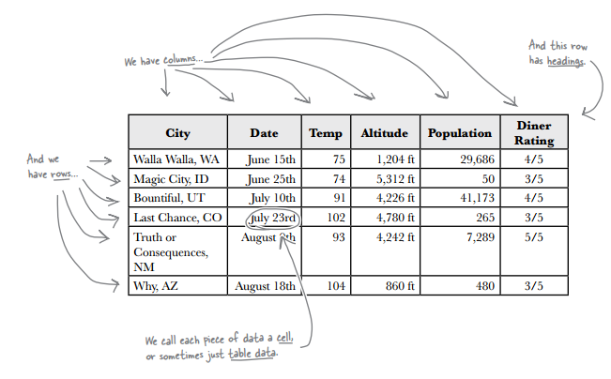
HTML Tables
You can create table-like layout using <div>’s and CSS but that is for layout purposes, and isn’t related to content itself.
HTML has a <table> element to take care of marking up tabular data.

Slide 4
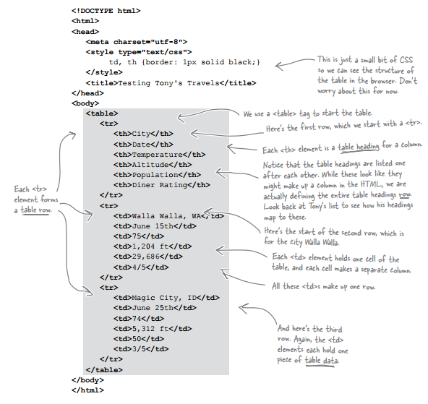
HTML Tables
Rows
Columns
Headers

Slide 5
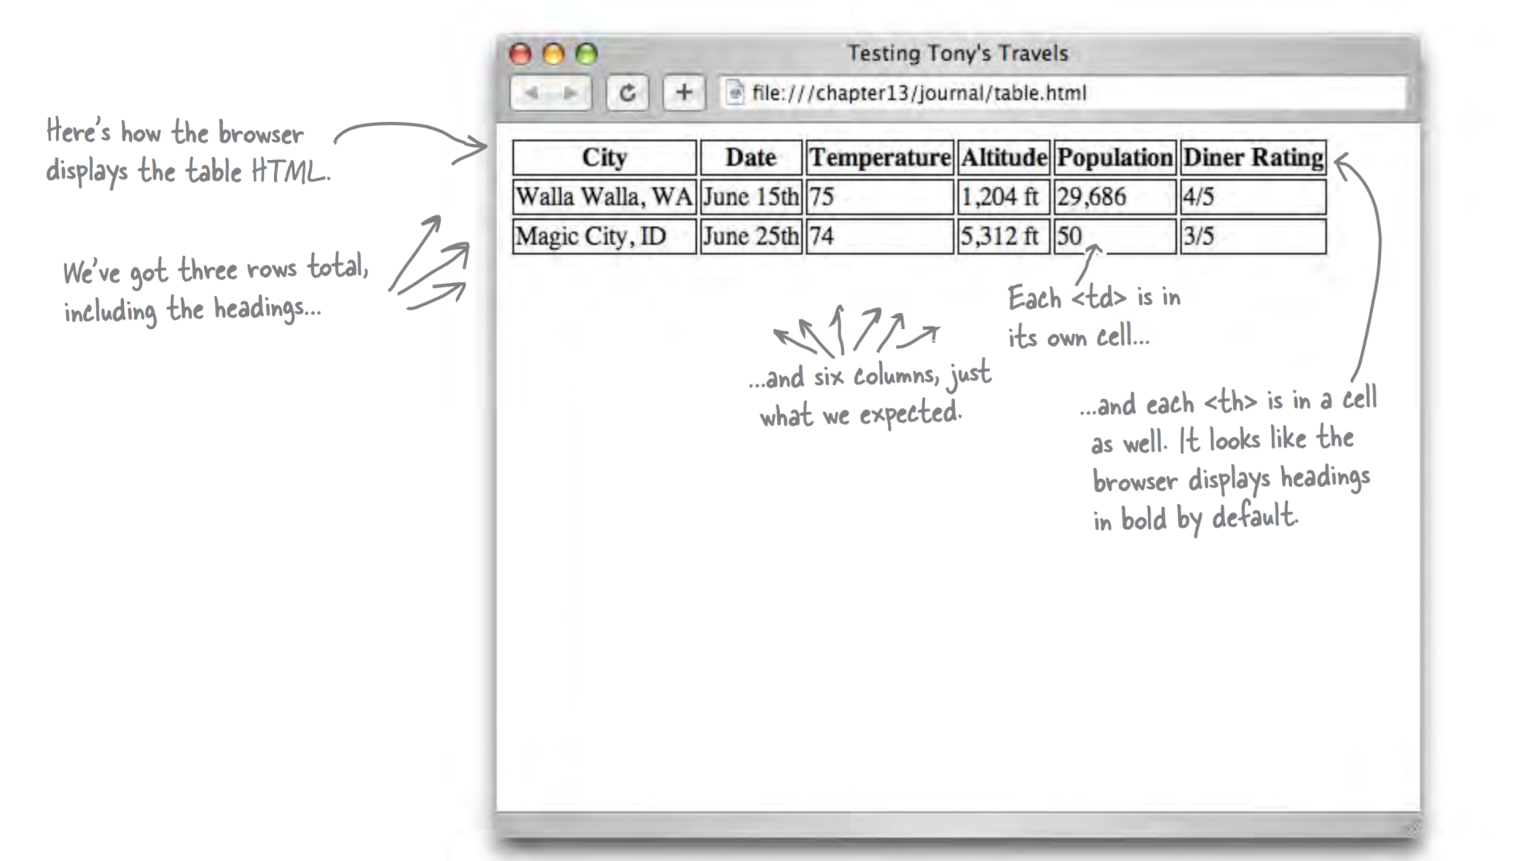
HTML Tables

Slide 6
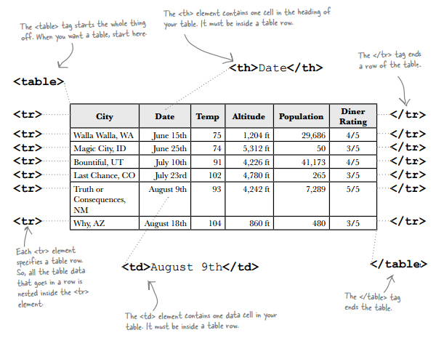
HTML Tables
We’ve seen four elements used to create a a single table:
<table>
<tr>
<th>
<td>.

Slide 7
HTML Tables
A table gives you a way to specify tabular data in your HTML.
Tables consist of data cells within rows. Columns are implicitly defined within the rows.
The number of columns in your table will be the number of data cells you have in a row.
In general, tables are not meant to be used for presentation: that’s the job of CSS.

Slide 8
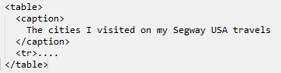
HTML Tables
Adding a caption – you can improve your table by adding a caption.
The caption is displayed in the browser. By default, most browsers display this above the table. If you don’t like the default location of the caption, you can use CSS to reposition it.

Slide 9
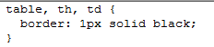
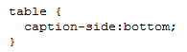
Styling HTML tables
To add a border, use:
To move the caption use:
To specify a single or double border around cells, use border-collapse.
When you have a double border , you can increase or decrease the space between each cell using border-spacing.

Slide 10
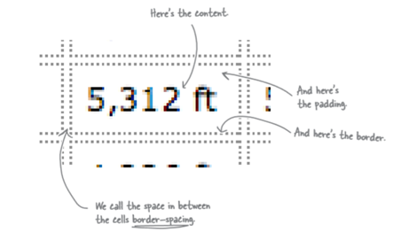
Styling HTML tables
By default each cell has a double border with some space between the borders:

Slide 11
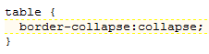
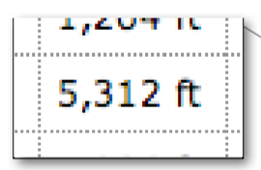
Styling HTML tables
The border-collapse property is set to separate by default (double border ). We can collapse the borders and have a single border:

Slide 12
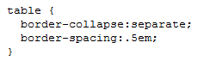
Styling HTML tables
If the border-collapse property is not set (remember it is separate by default); or is set to separate, you can also use the border-spacing property:

Slide 13
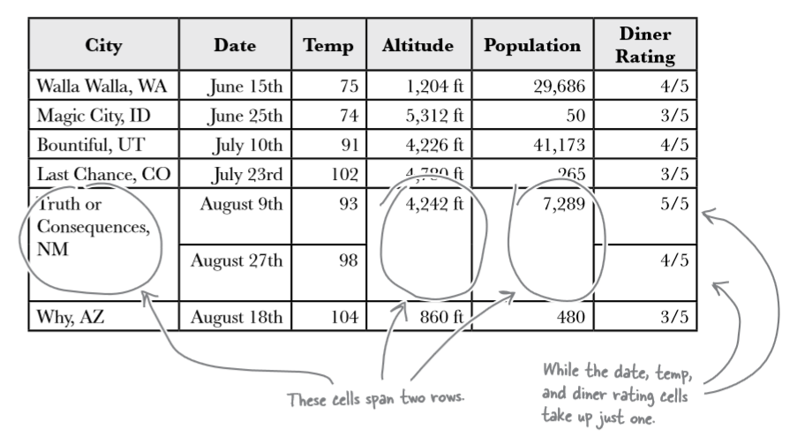
HTML tables
Sometimes tables have varying size cells. This is possible to define in HTML

Slide 14
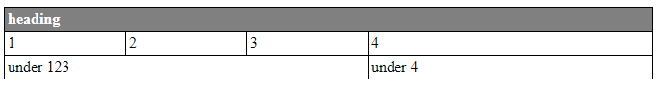

Slide 15
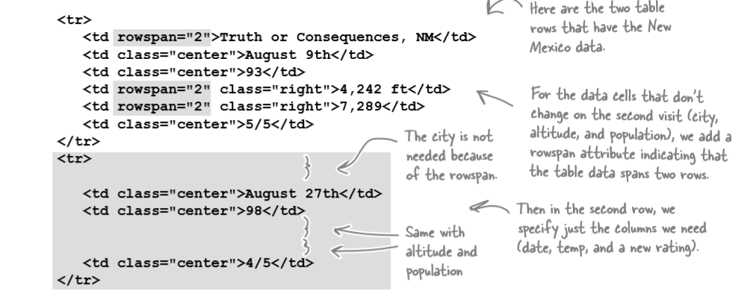
HTML tables
We use the attribute rowspan to define those cells that span more than one row.

Slide 16
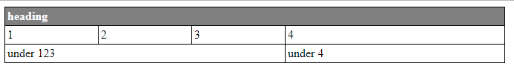
HTML tables
What about displaying two values in one cell?

Slide 17
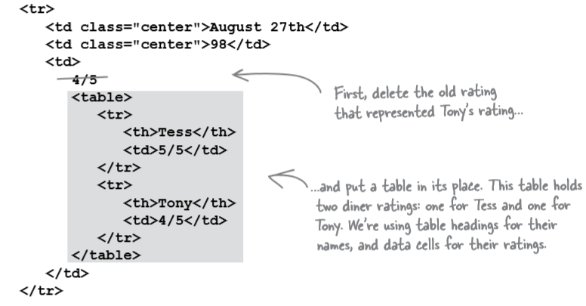
HTML tables

Slide 18
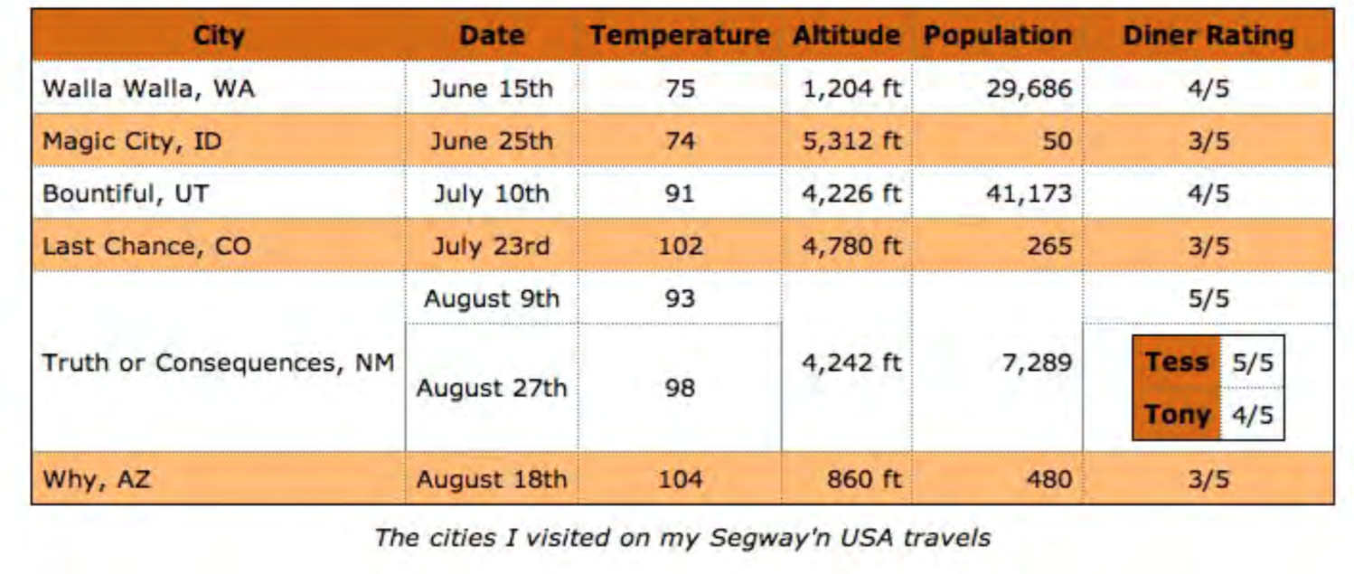
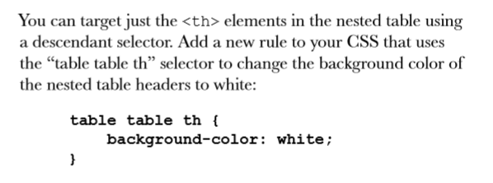
Ideally we don’t want the <th> for Tess and Tony to have the orange background colour.
This rule reads, for any table header in a table nested within another table give it a background colour white.

Slide 19
Styling HTML Tables
E.g. example you may want date, temperature, and diner rating to be centre-aligned. Perhaps right alignment on the altitude and population.
You could define two classes, one for centre-aligned and one for right-aligned. Then just use the text-align property in each. Then add the appropriate class to the correct <td> elements.

Slide 20
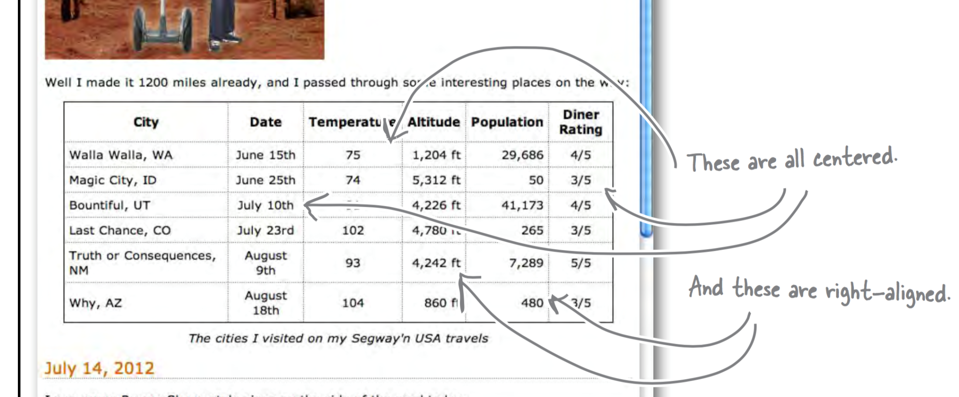
HTML tables

Slide 21
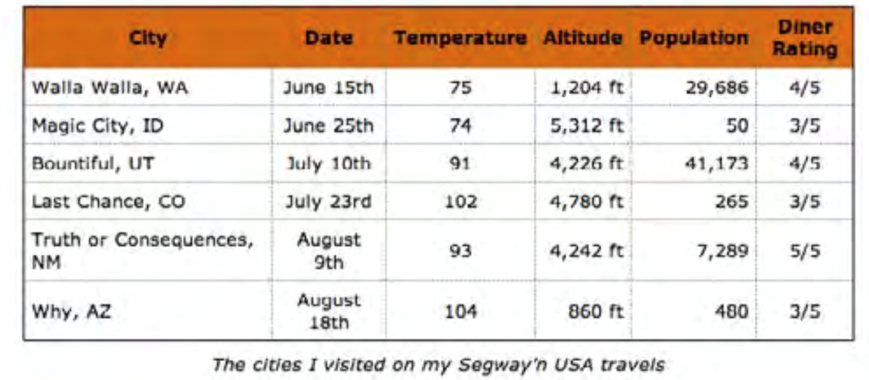
HTML tables
Style the header to have one background color and then alternate rows to have another color.
You can do this by placing the appropriate class name into every other <tr>

Slide 22
HTML tables
Instead of placing the class name into every other <tr> we can use another more advanced CSS method.
pseudo-classes is used to style elements based on their state, you may have seen the (a:hover pseudo-class).
For this example we can use the nth-child pseudo-class.
We can write a CSS rule to colour the even nth-child elements for the table row.

Slide 23
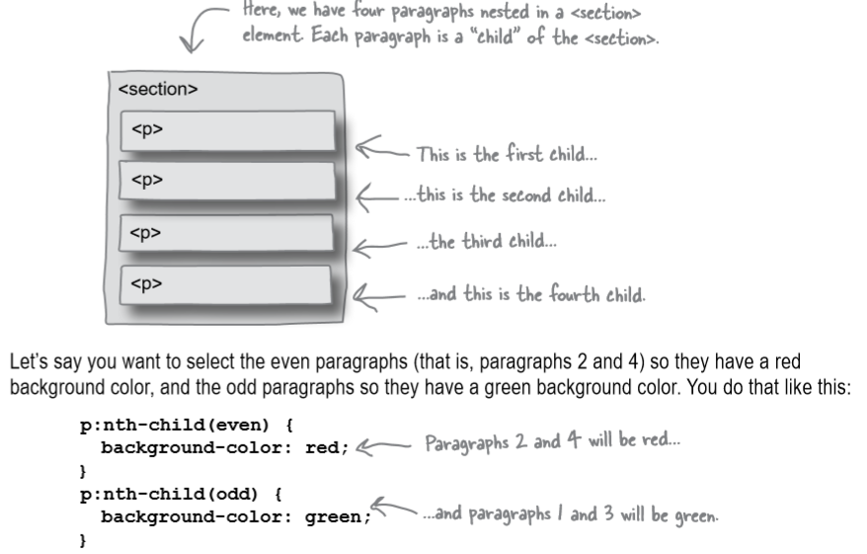
HTML tables

Slide 24
HTML tables
Sometimes tables have varying size cells. This is possible to define in HTML

Slide 25
HTML tables
We use the attribute rowspan to define those cells that span more than one row.

Slide 26
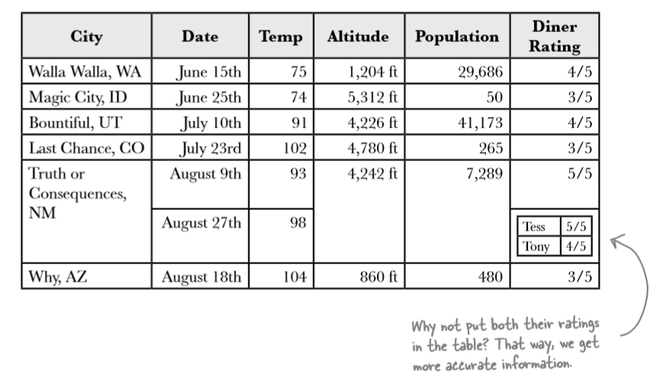
HTML tables
What about displaying two values in one cell?
It looks like a table within a table, we can do this by placing a <table> inside a <td>

Slide 27
HTML tables

Slide 28
Ideally we don’t want the <th> for Tess and Tony to have the orange background colour.
This rule reads, for any table header in a table nested within another table give it a background colour white.

